Slide 1
Chapter 4
Finding out about tasks and work

Slide 2
Task analysis
The examination of what users do
  Modeled as goals, tasks, and actions
Goals:
  the results that people want to achieve
Tasks:
  sets of related actions that can help achieve goals
Actions:
  (more or less) atomic components of tasks

Slide 3
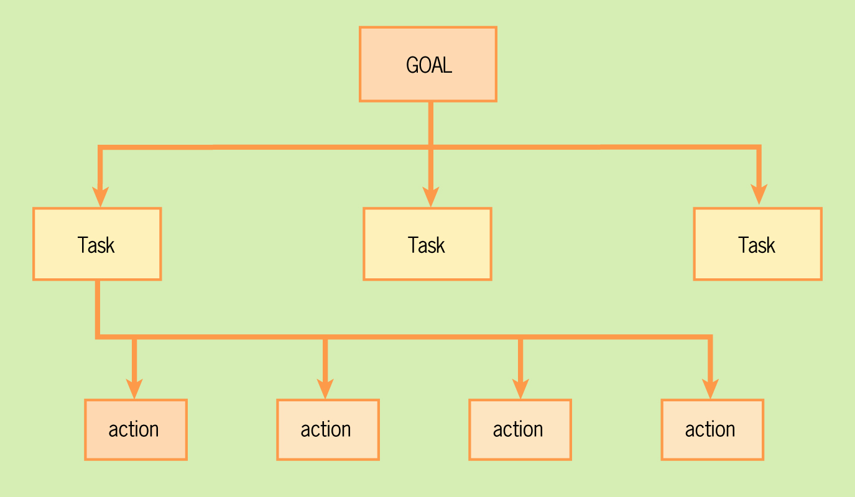
Goal-Task-Action Hierarchy

Slide 4
More on Goals and Tasks
Goals and tasks could be subdivided further
They may be different for different people
  Due to expertise (novice vs. expert users)
  Due to preference
Tasks are the central element
  Because systems support tasks

Slide 5
Task Characteristics
Variability of how task is performed
Frequency that task is performed
Knowledge and skill required
Environmental factors
Time criticality of task
Safety hazards
Will user work alone or with others?
Do users normally switch between several tasks?

Slide 6
Task analysis
Examines tasks and their characteristics
Two levels
  Workflow analysis:
    how groups of people perform tasks
  Job analysis
    how one person performs tasks or actions
Difficulties with current system provide clues to better design
  Look for use of external artifacts: notes, manuals, paper forms

Slide 7
Describing Tasks
Task scenarios
Use Cases
  Concrete
  Essential
Use scenarios

Slide 8
Task Scenarios
A narrative description of a task
  very detailed
Personalized for one person or persona
Intended to communicate an overall sense of the experience
Emphasis on the person

Slide 9
Concrete Use Cases
Resembles task scenario
  But not personalized … applies to all users
Presented as a series of pairs of
  User action
  System response
Describes actual use of current or envisioned system
Note: use cases in software engineering often have non-human users

Slide 10
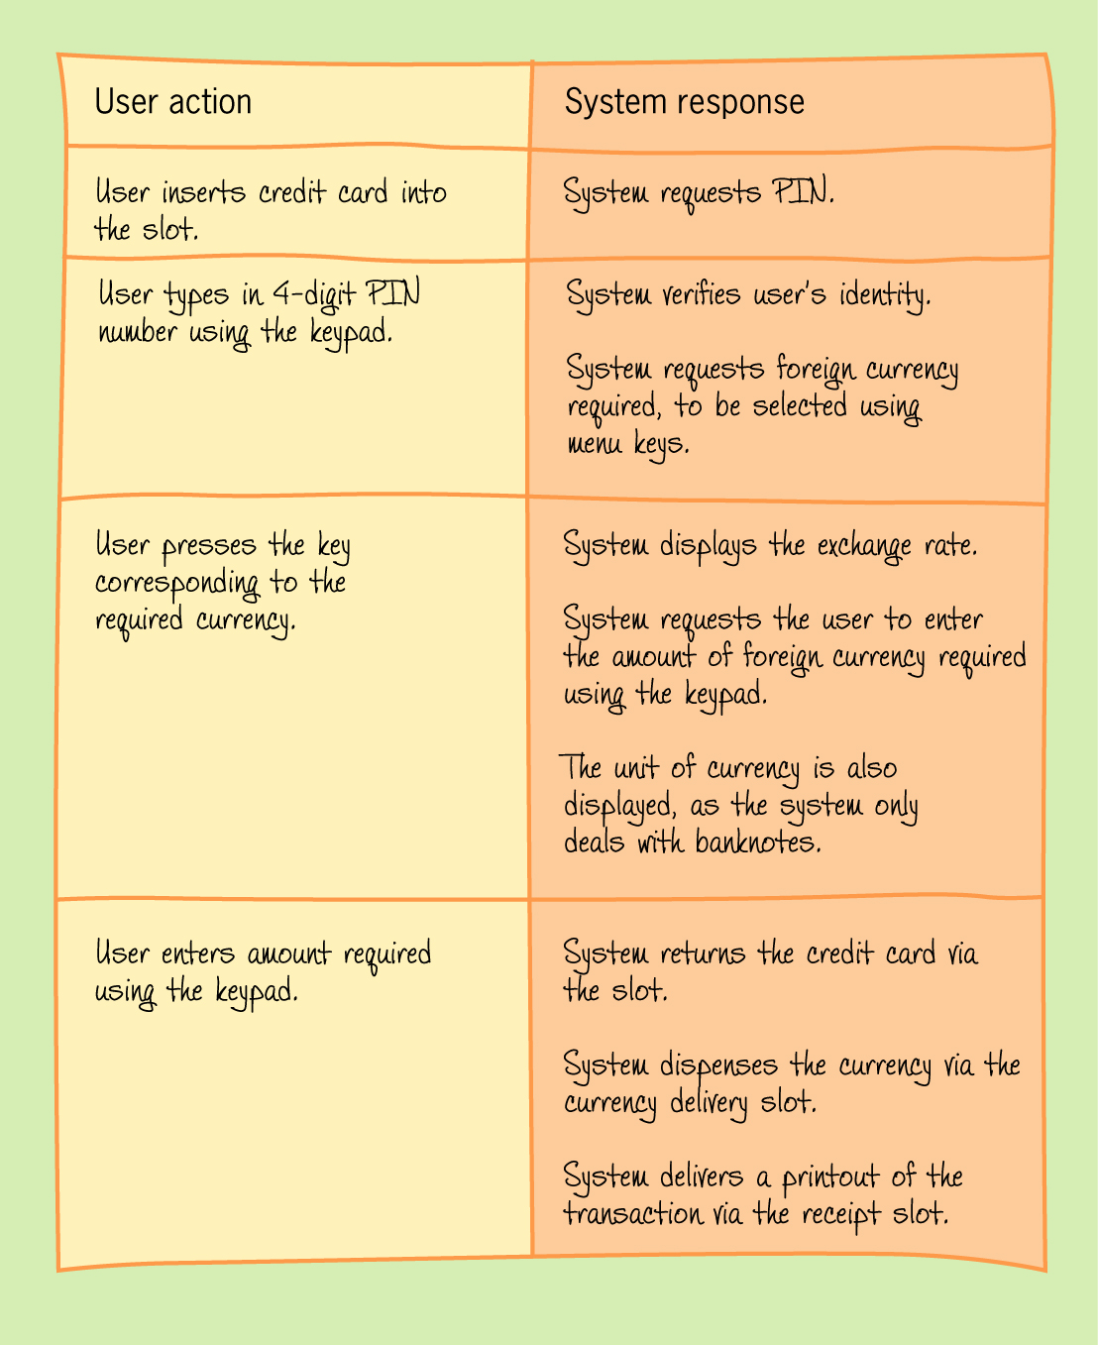
Concrete Use Case Example

Slide 11
Essential Use Case
More general than concrete use case
Intended to convey the “essence” of the interaction
  What is the user trying to do?
  What is the system responsible for doing?

Slide 12
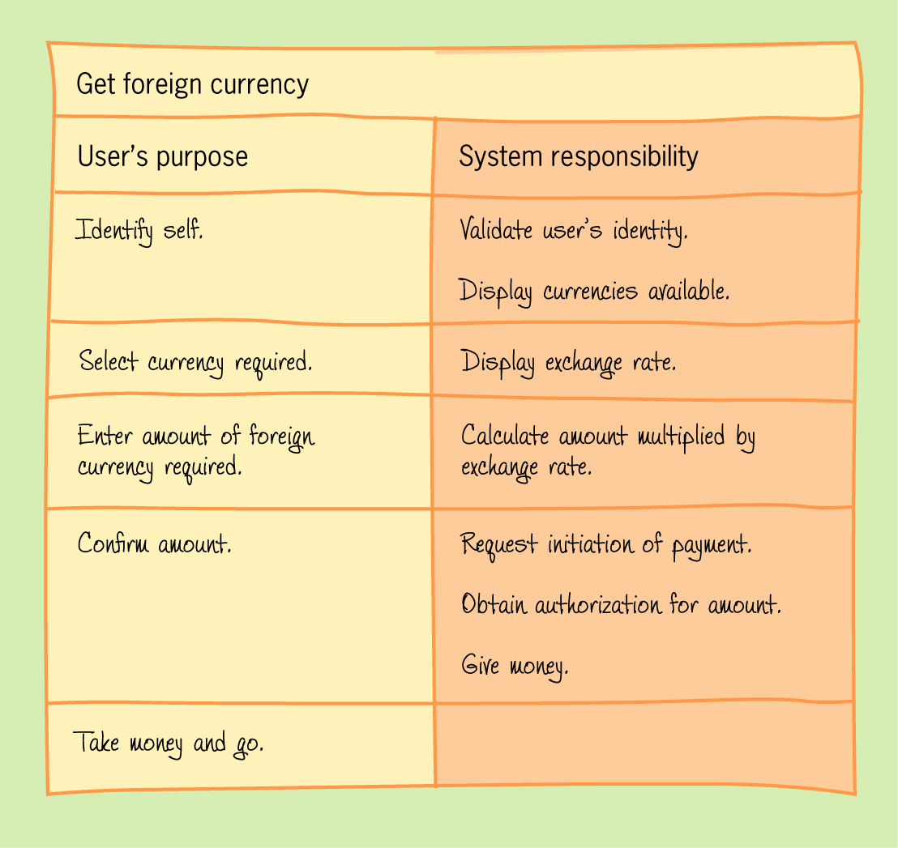
Essential Use Case Example

Slide 13
Cognitive Task Analysis
Looks at how users perform tasks, rather than just listing the tasks
  What is going on in their heads as they do the task?
Good for analyzing an existing system
Textbook has an excellent and very detailed example

Slide 14
Mental Models
Users build informal models of tasks and systems
  These models are imperfect
Structural: describe elements of the system
Functional: describe what you do with it
Mental models are derived naturally
  Can show you how users want a system to work
  Or how the system appears to them

Slide 15
Environmental Considerations
Where is the work done?
  Physical
  Safety
  Social
  Organizational

